Slide 1





Since 1994
شركة سبته التجارية ذ م م
SABTA TRADING CO. LLC
+971-4-2210506
www.sabtadxb.com
Dubai, UAE
P R O D U C T C A T A L O G

Slide 2

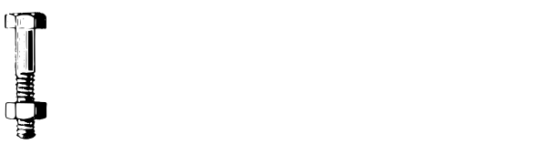










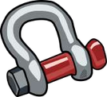

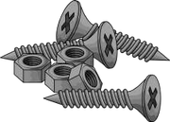
COMPANY PROFILE
SABTA TRADING CO. LLC, A Dubai-based company founded in 1994 as a Fastener Distributor Catering all types of fasteners mainly to Automotive, Manufacturing, Marine and Oilfield Industries. With vast expertise and knowledge throughout these years we have set standards for customer service by providing them with solutions to their problems.
We have succeeded in our industry due to our commitment, efficiency and determination in providing Quality products with a huge inventory of 16000 items in stock and competitive pricing. Our products get updated regularly to meet our valued clients demands.
With our dedicated list of suppliers, we can source you any type of Fasteners, which is not available in Ready stock.
1

Slide 3

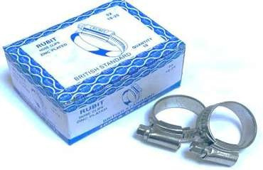
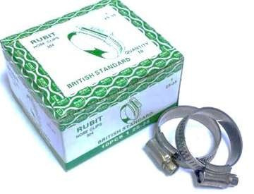
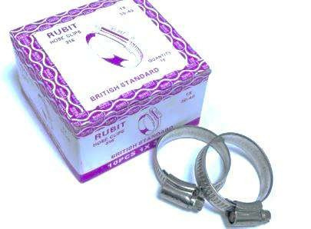
HOSE CLIP – RUBIT BRAND
SIZE: 3/8” – 12” AND 9.5 MM – 318 MM
Zinc-Plated Hose Clips are regarded as most reliable choice for general purpose usage as they are good for applications with low requirement in terms of corrosion resistance.
Stainless Steel 304 Hose Clips are ideal for various industrial applications where high corrosion resistance is required.
Stainless Steel 316 Hose Clips are widely regarded as Marine Grade Stainless Steel and is ideal for off-shore and salt water applications.
2

Slide 4

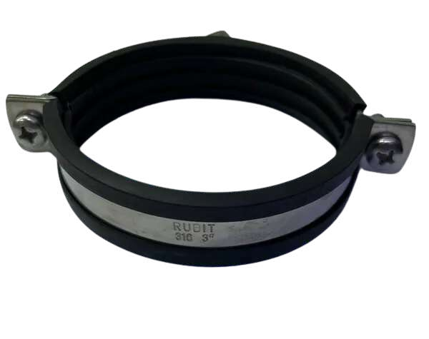

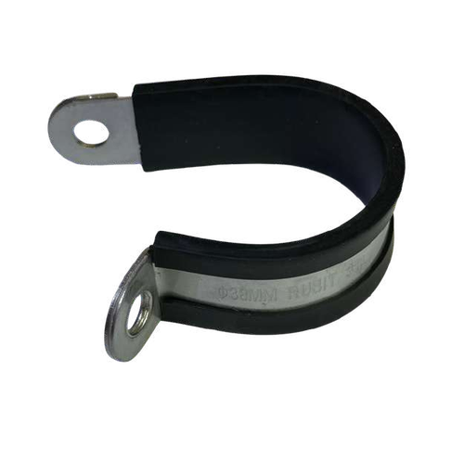
STAINLESS STEEL RUBBER HANGING CLAMP RUBIT BRAND
Grade: 304 & 316
STAINLESS STEEL P CLIP RUBIT BRAND
Grade: 304 & 316
3

Slide 5


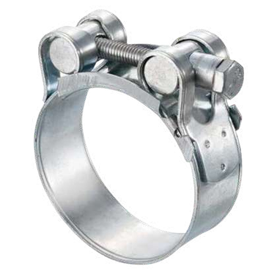
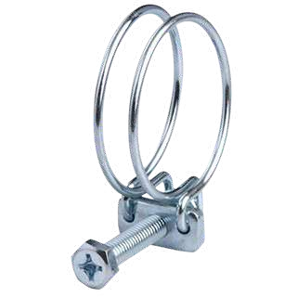
SINGLE BOLT CLAMP RUBIT BRAND
Grade: GI, 304 & 316
Double Wire Clamp
Grade: GI
4

Slide 6

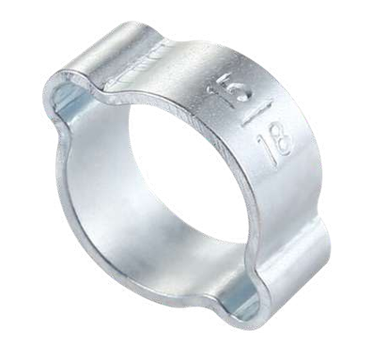
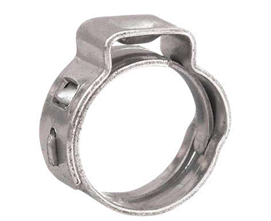
Double Ear Clamp RUBIT BRAND
Grade: GI
Single Ear Clamp RUBIT BRAND
Grade: 304
5

Slide 7
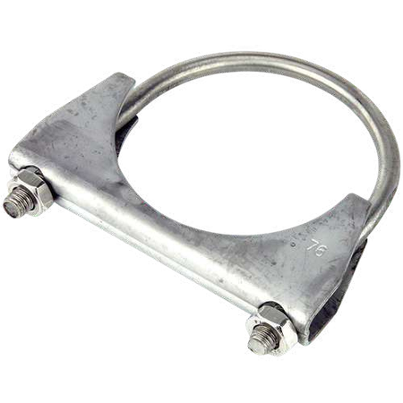

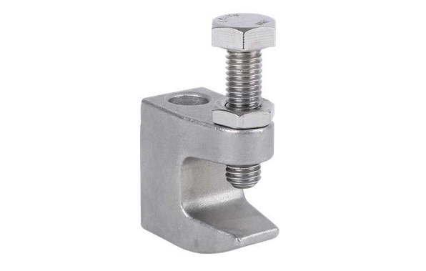
MUFFLER CLAMP RUBIT BRAND
Grade: GI, 304 & 316
BEAM CLAMP RUBIT BRAND
Grade: 304
6

Slide 8
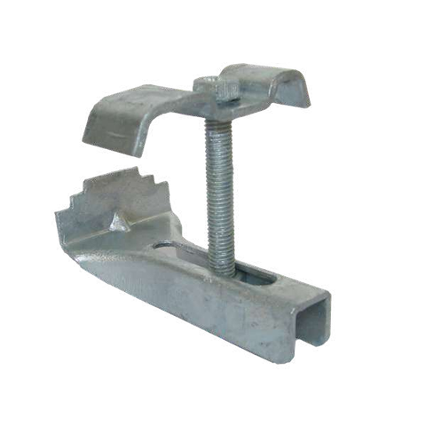
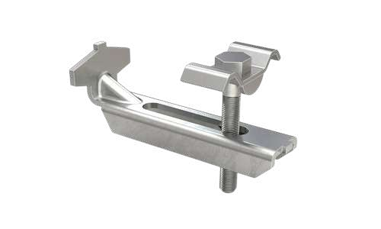
HDG GRATING CLAMP
SS GRATING CLAMP
Grade: 304 & 316
7

Slide 9

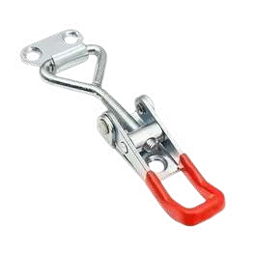

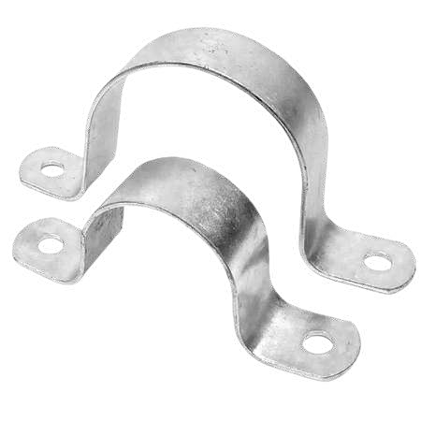
TOGGLE
Grade: GI, 304
SADDLE CLAMP
Grade: GI, 304
8

Slide 10


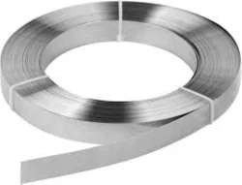

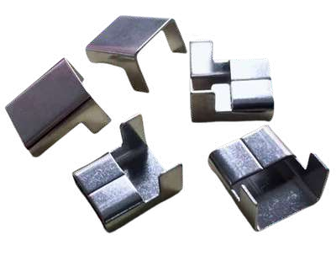
BANDING STRIP
Grade: 304 & 316
BANDING STRIP CLIPS
Grade: 304 & 316
9

Slide 11
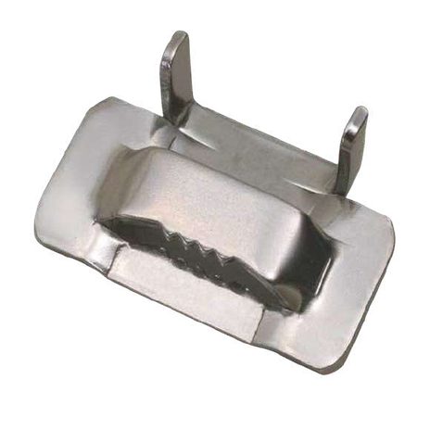
EAR LOKT BUCKLES
Grade: 304 & 316
10

Slide 12
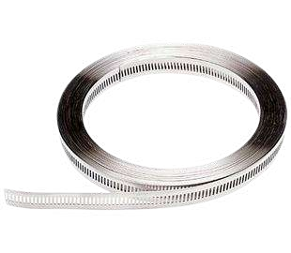
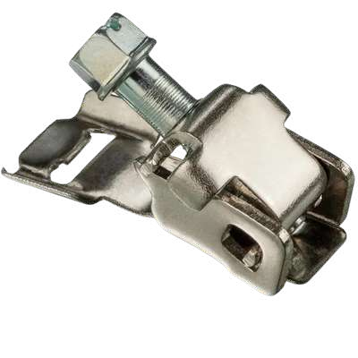
MULTI-BAND RUBIT BRAND
Grade: 304
MULTI-BAND SCREW RUBIT BRAND
Grade: 304
11

Slide 13
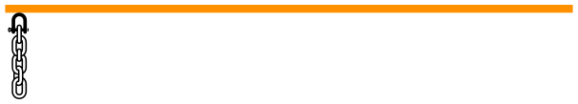

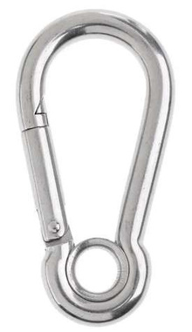
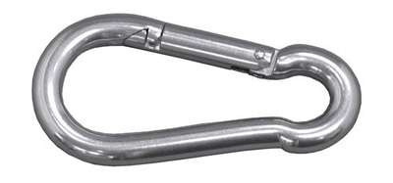
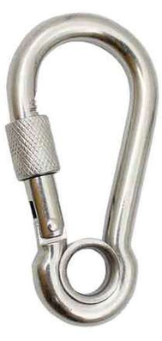

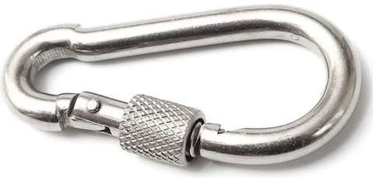
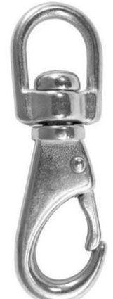

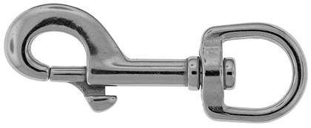
RIGGING HARDWARE
SNAP HOOK
SNAP HOOK WITH EYE
Grade: GI, 304, 316
Grade: 304, 316
SNAP HOOK WITH LOCK
SNAP HOOK WITH EYE LOCK
Grade: 304, 316
Grade: 304, 316
SWIVEL EYE SNAP HOOK
SWIVEL EYE SNAP BOLT
Grade: 304, 316
Grade: 304, 316
12

Slide 14


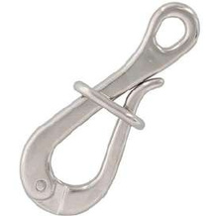
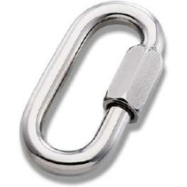
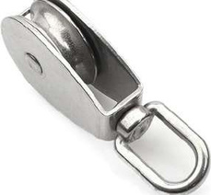
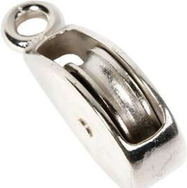
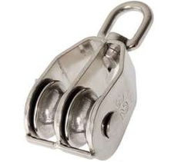
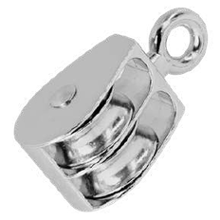
RIGGING HARDWARE
PELICAN HOOK
QUICK LINK
Grade: 304, 316
Grade: GI, 304, 316
PULLEY SWIVEL SINGLE WHEEL
PULLEY FIXED SINGLE WHEEL
Grade: Nickle, 304, 316
Grade: Nickle
PULLEY SWIVEL DOUBLE WHEEL
PULLEY FIXED DOUBLE WHEEL
Grade: Nickle, 304, 316
Grade: Nickle
13

Slide 15
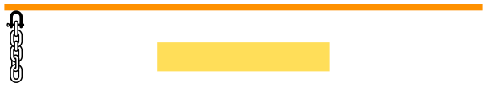
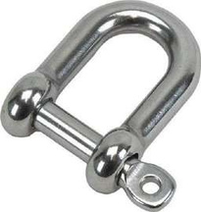
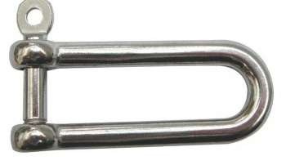
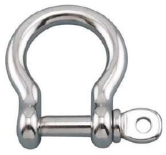
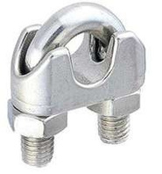

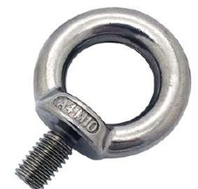
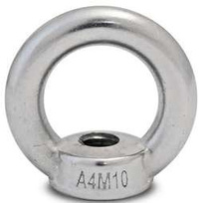
RIGGING HARDWARE
D SHACKLE
LONG D SHACKLE
Grade: GI, 304, 316
Grade: 304, 316
BOW SHACKLE
WIRE ROPE CLIP
Grade: GI, 304, 316
Grade: GI, 304, 316
LIFTING EYE BOLT
LIFTING EYE NUT
Grade: GI, 304, 316
Grade: GI, 304, 316
14

Slide 16
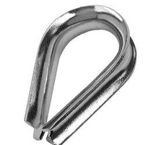
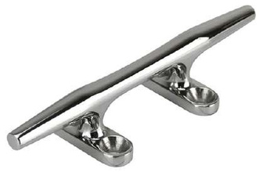
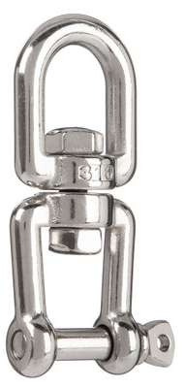
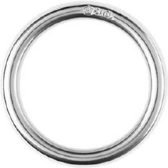
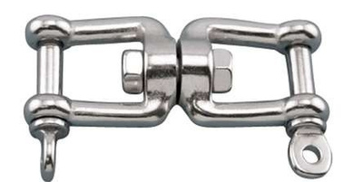
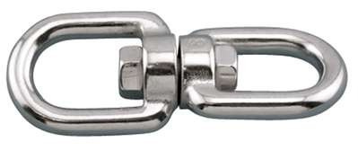
RIGGING HARDWARE
THIMBLE
CLEAT
Grade: GI, 304, 316
Grade: 304, 316
O RING
SWIVEL JAW & EYE
Grade: GI, 304, 316
Grade: 304, 316
SWIVEL JAW & JAW
SWIVEL EYE & EYE
Grade: 304, 316
Grade: 304, 316
15

Slide 17
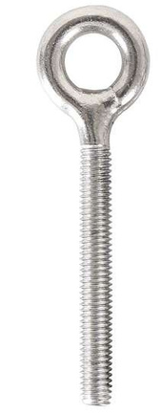





RIGGING HARDWARE
EYE BOLT
EYE HOOK BOLT
Grade: 304, 316
Grade: 304, 316
DOG BOLT
TOGGLE NUT / BUTTERFLY NUT
Grade: 304, 316
Grade: 304, 316
U BOLT WITH BRACKET
RING EYE BOLT
Grade: 304, 316
Grade: 304, 316
16

Slide 18








RIGGING HARDWARE
ROUND EYE PLATE
OBLONG PAD EYE
Grade: 304, 316
Grade: 304, 316
DIAMOND PAD EYE
SQUARE EYE PLATE
Grade: 304, 316
Grade: 304, 316
SQUARE PLATE WITH RING
PAD EYE STRAP
Grade: 304, 316
Grade: 304, 316
17

Slide 19












RIGGING HARDWARE
TURNBUCKLE HOOK TO EYE
TURNBUCKLE EYE TO EYE
Grade: GI, 304, 316
Grade: 304, 316
TURNBUCKLE HOOK TO HOOK
TURNBUCKLE JAW TO JAW
Grade: 304, 316
Grade: 304, 316
TURNBUCKLE PIPE JAW TO JAW
D RING
Grade: 304, 316
Grade: 304, 316
18

Slide 20








RIGGING HARDWARE
DELTA QUICK LINK
BOW NUT
Grade: 304, 316
Grade: 304, 316
BOW SHACKLE - BOLT TYPE
D SHACKLE - BOLT TYPE
Grade: 304, 316
Grade: 304, 316
SS CARGO HOOK FIXED
SS CARGO HOOK SWIVEL
Grade: 304, 316
Grade: 304, 316
19

Slide 21













RIGGING HARDWARE
SS CLEVIS GRAB HOOK
FERRULE
Grade: 304, 316
Grade: Aluminum, 304
ROUND
8 TYPE
WIRE ROPE HANG HOOK
Grade: Aluminum
Grade: 304
CROSS WIRE ROPE CLIP
WIRE ROPE CLIP
SIMPLEX DUPLEX
Grade: 304, 316
Grade: 304, 316
20

Slide 22











RIGGING HARDWARE
WIRE ROPE
PVC WIRE ROPE
Grade: GI, 304, 316
Grade: GI, 304, 316
BINDING WIRE
WIRE MESH
Grade: 304
Grade: 304
LINK CHAIN
GI CHAIN (30 MTR BAG)
Grade: 304, 316
21

Slide 23









LIFTING MARINE HARDWARE
D SHACKLE - SCREW PIN
BOW SHACKLE - SCREW PIN
Grade: Hot-Dip Galvanized
Grade: Hot-Dip Galvanized
D SHACKLE - BOLT TYPE
BOW SHACKLE - BOLT TYPE
Grade: Hot-Dip Galvanized
Grade: Hot-Dip Galvanized
WIRE ROPE CLIP
CARGO LATCH KIT
Grade: Hot-Dip Galvanized
Grade: GI
22

Slide 24







LIFTING MARINE HARDWARE
320A EYE HOOK
322A SWIVEL HOOK
Grade: GI, Alloy
Grade: GI, Alloy
G70 CLEVIS GRAB HOOK
G80 CLEVIS SLING HOOK
Grade: GI, Alloy
Grade: GI, Alloy
G80 CONNECTING LINK
G80 CLEVIS SELF LOCKING HOOK
Grade: GI, Alloy
Grade: GI, Alloy
23

Slide 25






LIFTING MARINE HARDWARE
G80 EYE SELF LOCKING HOOK
LOAD BINDER RATCHET TYPE
Grade: GI, Alloy
Grade: GI, Alloy
LOAD BINDER LEVER TYPE
SHOTENIGN CLUTCH
Grade: GI, Alloy
Grade: GI, Alloy
MASTER LINK
ROTATING SELF LOCKING HOOK
Grade: GI, Alloy
Grade: GI, Alloy
24

Slide 26

LIFTING MARINE HARDWARE
G80 MS CHAIN
Grade: G80
25

Slide 27






CLIPS & PINS
CIRCLIP EXTERNAL - DIN471
CIRCLIP INTERNAL - DIN472
Grade: MS, 304
Grade: MS, 304
SNAP RING EXTERNAL
E CLIPS
Grade: MS
Grade: MS, 304
SPRING TENSION PIN
SPIRAL PIN
Grade: MS, 304
Grade: MS
26

Slide 28







CLIPS & PINS
SOLID DOWEL PIN
CLEVIS PIN
Grade: 8
Grade: Yellow
HITCH PIN
QUICK RELEASE PIN
Grade: Yellow
Grade: GI
TABLE LOCK PIN ROUND
TABLE LOCK PIN SQUARE
Grade: GI
Grade: GI
27

Slide 29







CLIPS & PINS
TABLE LOCK PIN SQUARE WITH EYE
TUBE PIN
Grade: GI
Grade: GI
LYNCH PIN
INDUSTRIAL SAFETY PIN
Grade: Yellow, 304
Grade: GI, 304
R PIN / DOUBLE RING R PIN
SPLIT PIN / COTTER PIN
Grade: GI, 304
Grade: GI, 304
28

Slide 30











BOLTS / SCREWS
HEX BOLT - DIN931/933
FLANGE BOLT - DIN6921
Grade: 8.8, 10.9, 12.9, 304, 316
Grade: GI, 304
WING BOLT - DIN316
T SOLT BOLT
Grade: GI, 304
Grade: 304
ROOFING BOLT
CARRIAGE BOLT
Grade: 8.8, 304
Grade: 8.8, 304
29

Slide 31








BOLTS / SCREWS
THREADED BAR - DIN975
FULL THREADED STUD BOLT
Grade: 8.8, B7, 304, 316
Grade: 8.8, B7, 304, 316
ENGINEERING STUD BOLT
SOCKET CAP SCREW - DIN912
Grade: 8.8, B7, 304, 316
Grade: 8.8, 12.9, 304, 316
LOW HEAD SOCKET CAP SCREW
SOCKET PRESSURE PLUG - DIN986
Grade: 12.9, 304
Grade: 12.9, 304
30

Slide 32





BOLTS / SCREWS
U BOLT
CSK MACHINE SCREW PIN
Grade: 8.8, 304, 316
Grade: 8.8, 304, 316
PAN HEAD MACHINE SCREW
WELD STUD
Grade: 8.8, 304, 316
Grade: 304
COPPER WELD STUD
31

Slide 33











NUTS
HEX NUT - DIN934
HEX CAP NUT - DIN1587
Grade: 8.8, 10.9, 2H, 304, 316
Grade: 8.8, 304, 316
LOCK NUT - DIN985
SPRING NUT
Grade: 8.8, 304, 316
Grade: 8.8, 304, 316
CAGE NUT
PAL NUT - DIN7967
Grade: GI, 304
Grade: GI, 304
32

Slide 34







NUTS
CASTLE NUT
WING NUT - DIN315
Grade: 8.8, 304
Grade: GI, 304
FLANGE NUT - DIN6923
TEETH NUT - DIN1624
Grade: GI, 304, 316
Grade: GI, 304, 316
RIVET NUT
REDUCED HEAD RIVET NUT
Grade: GI, 304
Grade: GI, 304
33

Slide 35










NUTS
CLIP NUT
CAPTIVE NUT
Grade: GI
Grade: GI
PVC BOLT CAP
CONICAL LOCK NUT
Color: Black, White, Grey
Grade: GI
FULL STEEL LOCK NUT
K NUT
Grade: GI
Grade: SS 304
34

Slide 36



NUTS
KM LOCK NUT
T SLIDE NUT
Grade: MS, SS 304
Grade: SS 304
PVC BOLT CAP
CONICAL LOCK NUT
Color: Black, White, Grey
Grade: GI
FULL STEEL LOCK NUT
K NUT
Grade: GI
Grade: SS 304
35

Slide 37







NUTS
SQUARE NUT
WELD NUT
Grade: SS 304
Grade: SS 304
COUPLING NUT
THIN NUTS
Grade: GI, SS 304
Grade: GI, SS 304
36

Slide 38









WASHERS
FLAT WASHER
SPRING WASHER - DIN127
DIN125 DIN9021
Grade: 8.8, 304, 316
Grade: 8.8, 304, 316
STARLOCK WASHER
SERRATED WASHER
DIN6798 J / DIN6798A
Grade: Bronze, 304
Grade: GI, 304
CONTACT WASHER - NFE25511
NORDLOCK WASHER - NFE25201
Grade: GI, 304
Grade: HDG, 304
37

Slide 39










WASHERS
COPPER
ALUMINUM
MB LOCK WASHER
Grade: MS
DISC WASHER
SHIM WASHER
Grade: MS
Grade: GI
BONDED SEAL WASHER
KNURLING WASHERWAVE WASHER
Grade: MS
38

Slide 40








MISC. HARDWARE
GREASE NIPPLE
GREASE NIPPLE BUTTON HEAD
Grade: GI, 304
Grade: GI, 304
LONG GREASE NIPPLE
GREASE NIPPLE CUP
Grade: GI
Grade: GI
GREASE NIPPLE CAP
GREASE ADAPTOR
Green & Red Color
39

Slide 41










MISC. HARDWARE
GREASE ADAPTOR - BUTTON HEAD
GREASE ADAPTOR BUTTON HEAD
Material: Brass
GREASE ADAPTOR PIN TYPE
GREASE NIPPLE HOSE
GREASE NIPPLE PIN TYPE
BANJO BOLT
Material: Nickel
Material: GI
40

Slide 42






MISC. HARDWARE
THREADING TAPS
TAP WRENCH (TAP HANDLE)
PITCH: LEFT THREAD, STANDARD, FINE THREAD, NPT, BSP, UNC, UNF, BSW, BSF
ROUND DIE HANDLE
ROUND DIE (DIE NUT)
PITCH: LEFT THREAD, STANDARD, FINE THREAD, NPT, BSP, UNC, UNF, BSW, BSF
HEX DIE
HAMMERING RIVET
PITCH: STANDARD, FINE THREAD
Grade: GI, 304
42

Slide 43









MISC. HARDWARE
O RING CORD
O RING CLOSED RING
DRAW TOGGLE LATCH
NBR70, VITON
O RING KIT - NBR70 INCH & METRIC
WORKSHOP ASSORTMENT
CUSTOMIZABLE AS PER CUSTOMER NEEDS
SPRING TOGGLES
FLAT KEY (KEY BAR)
Grade: GI, 304
43

Slide 44










MISC. HARDWARE
THREAD INSERT
THREAD REPAIR KIT
S.R.C RIVETS
RIVET GUN HR-730
Grade: Aluminum, 304, 316
RIVET GUN HR-750
S HOOK
Grade: GI, 304
44

Slide 45







شركة سبته التجارية ذ م م
SABTA TRADING CO. LLC
Phone: +971 4 2210506 {4 Lines} | Fax: +971 4 2243009 |
P.O. Box: 14684, Dubai-U.A.E
SAIFUDDIN Managing Director
HUSAIN
ALI ASGAR
+971 50 5649976 ali@sabtadxb.com
+971 50 5092067 husain@sabtadxb.com
Location

